Slide 1
4th Peace Practitioners Reserach Conference
Regency Angkor Hotel, Siem Reap, Kingdom of Cambodia
9-10 December 2015

Slide 2
CURRENT POLITICAL LANDSCAPE AND
PEACE PROCESS
Ethnic Armed Organizations – Signatories (8)
To continue lay the foundation for peace process/political dialogue process with current government
Ethnic Armed Organizations – Non-Signatories (13)
Wait to dialogue with new government
NEW GOVERNMENT AND PEACE PROCESS
WAIT and SEE
၃ ၄

Slide 3
Peace
Practitioner’s
Role
SELF
Track -3
SELFNy
Track – 2
Track – 1.5
Facilitation
Technical support
Mobilizer
Track - 1
Advocate
Ceasefire Negotiation
Civil Society Forum for Peace
Civilian Ceasefire Monitoring

Slide 4
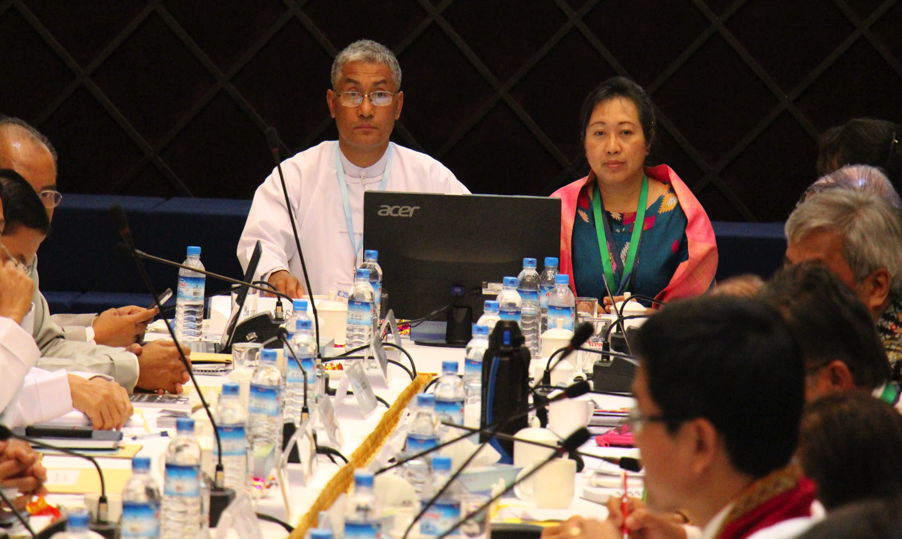
  “Insider-Partial”
Co-Facilitator

Slide 5
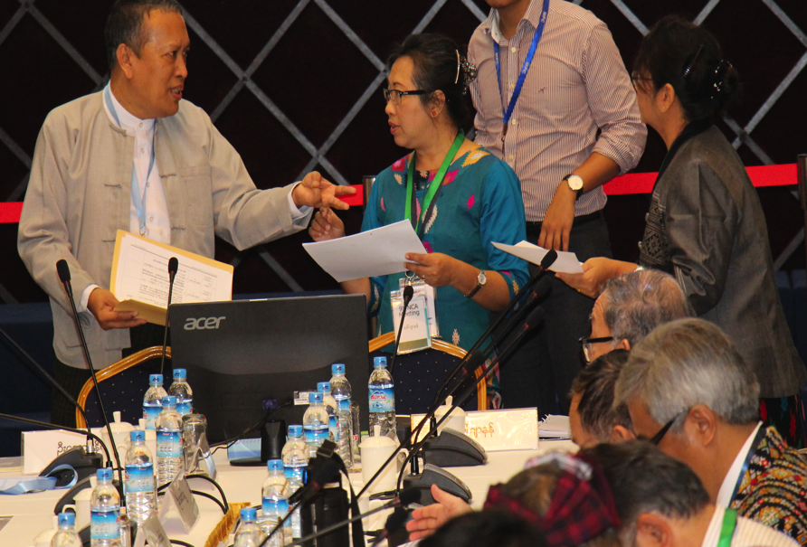
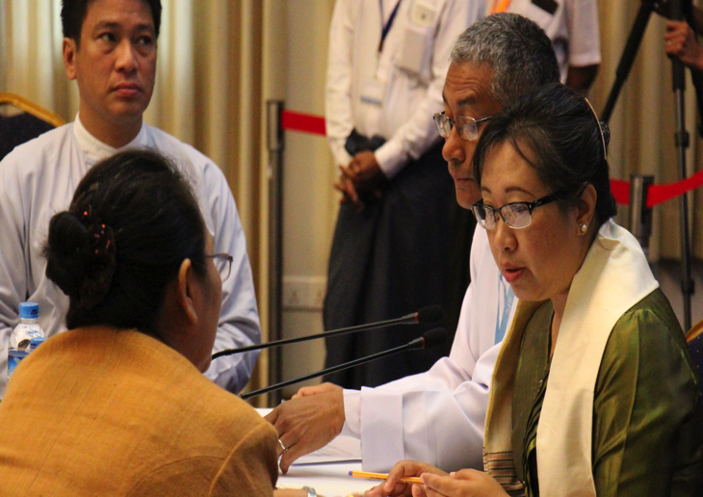
Impartial
Facilitation
No external 3rd party
Myanmar – OWN WAY
Facilitators……
Influence
the design of the process
And
process of the talks

Slide 6
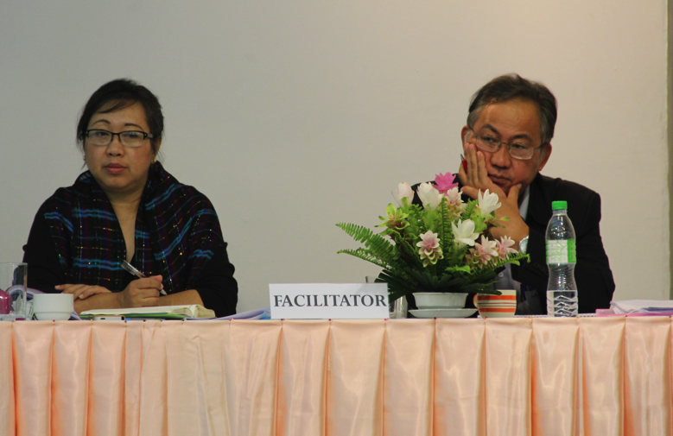
“Impartial facilitator of the process”
    To be objective; technically strong
    Way of communication to the team you represent during the talks
    mindful about building relationship with the other side
    Facilitator is not a decision maker at the table (you can suggest options
    Not to over do the paraphrasing nor summarizing (Generals in uniform gets impatience)
Sometimes…
Just
LET THEM TALK

Slide 7
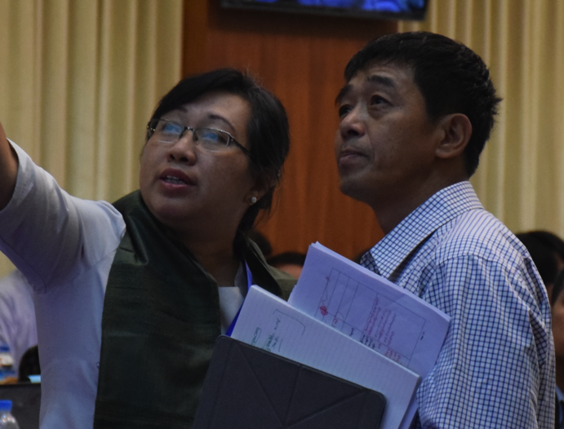
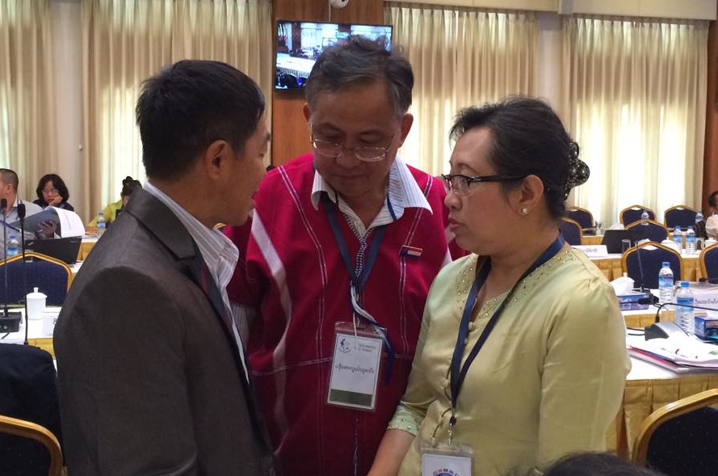
Able to influence the negotiators
They do the job
(e.g. draft agenda, draft
the text, insert opinion)
Technical
Advisor
Develop professional relationship with the technical team of the other side
Develop team work between the technical teams from both sides

Slide 8
Thank You

