Slide 1
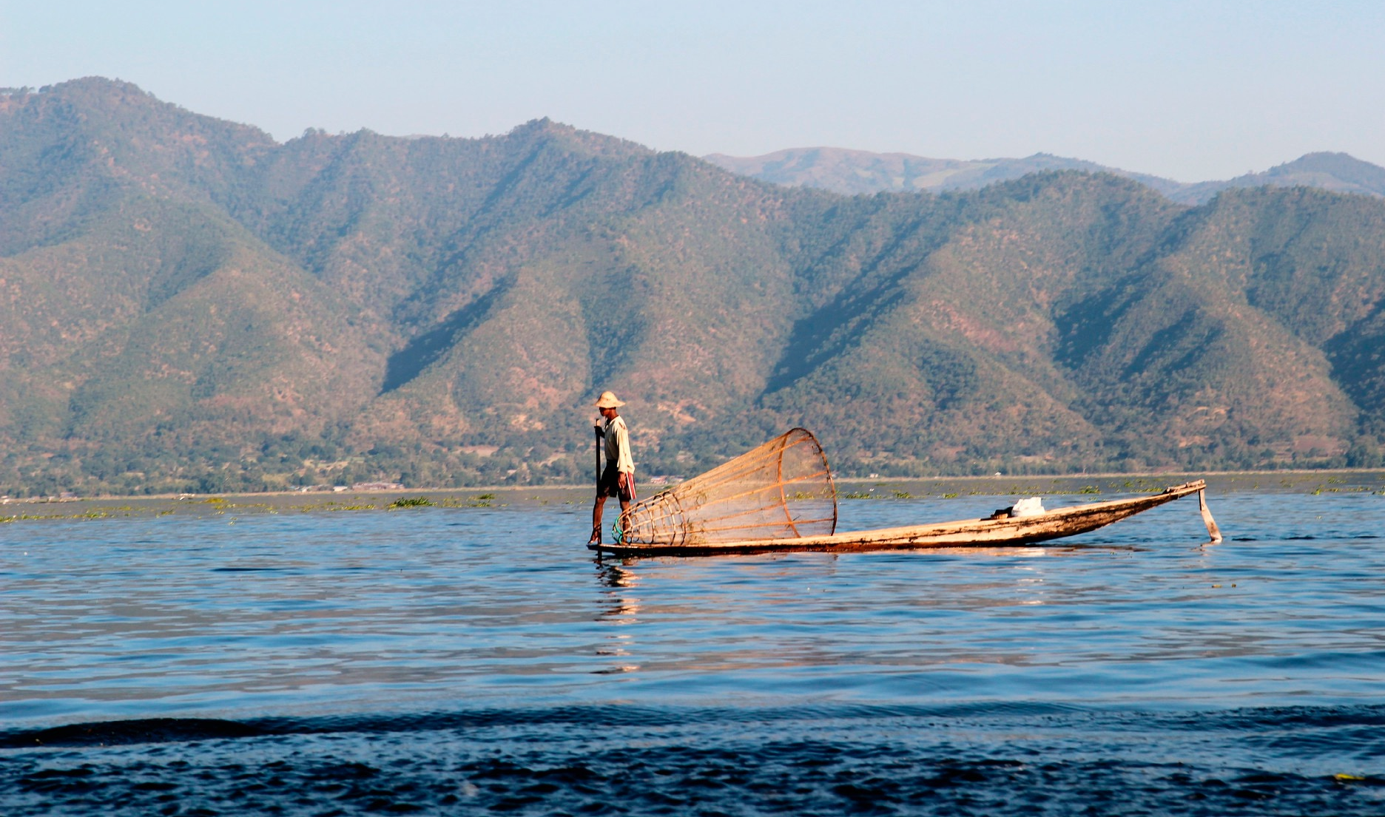
Exploring peace infrastructure in Southern Shan State, Myanmar
Htet Oo Wai
10 December 2015
Peace Practitioners Conference

Slide 2
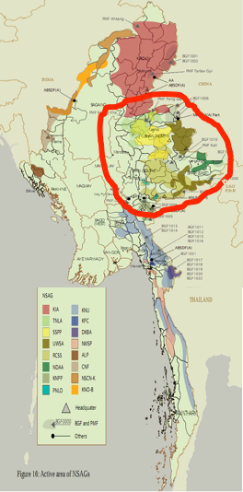

Conflict Context
Shan state is the microcosm of Myanmar
Fighting in Southern Shan State only formally ended in 2012
“Peace” as the political terminology and see as part of the revolutionary movement against the ruling government
Majority people see peace as the absence of war and the violence
Notes:
Shan state is the microcosm of Myanmar (Diversities of community, culture, ethnic and belief with existing conflicts and tensions among the groups)
Fighting in Southern Shan State only formally ended in 2012 with the signing of a peace agreement between the Shan State Army-South/Restoration Council of Shan State and the government led by President Thein Sein (refers to BNI reports 2013, 2014)
People see peace as the negative peace (the absence of violence and the absence of war) as the only solution for their suffering.

Slide 3
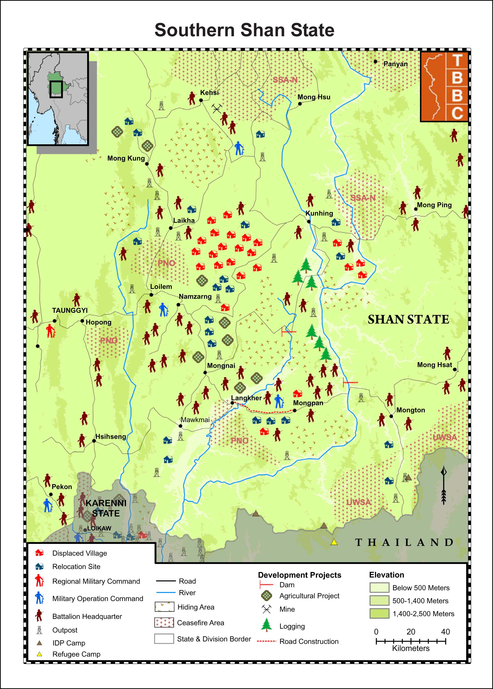
Conflict Context (cont:)
Majority of institutions and organizations’ activities in Southern Shan State are focusing in short term peace building (peace-building initiatives for long-term sustainable focus is hardly seen and or lacking in Southern Shan State)
• the presence of armed groups, Myanmar military and the availability of weapons around Southern Shan State has created a militarized society where the logic of violence continues to play an important role in the way that groups resolve conflicts

Slide 4
Research Objectives
To discover the existing peace infrastructure in Southern Shan State
To identify what kind of peace infrastructure is necessary to be built in Southern Shan State
To find out what kind of peace related skills and knowledge are needed for peace infrastructure in Southern Shan State

Slide 5
I. Is there any peace infrastructure in Southern Shan State, if not why?
The existence of peace infrastructures is hard to notice due to its limited role of legitimacy gain from the community
Civil Society Organisations (CSOs) has been recognised as the source of peace education, the local information and accessing the culture and practices of the society and the situation context, as a centre supporting peace mechanisms, as mediator/ facilitator/ representatives
Religious Institution, leaders and organizations used to be the best symbols for peace infrastructure and being authorized as the source of peaceful resolution and transforming conflict non-violently
Local patterns and systems of peaceful resolutions has been transform and/or hidden by the political discourses among and between different governing groups

Slide 6
I. Is there any peace infrastructure in Southern Shan State, if not why? (cont:)
It is hard to define whether there is a systematic pattern of those relationships (Peace infrastructure can be seen as lacking in this scenario)
collaborative efforts and networking initiatives are still very limited in Southern Shan State
There are official administrative mechanisms for conflicting issues that people are facing, such as police, court, administration department, etc. (mostly when it relates to crimes)
The lack of stable peaceful conditions in the community in Southern Shan State places a great burden on communities and leave vulnerability to structural and latent conflicts

Slide 7
II. If there is no peace infrastructure in Southern Shan State, what kind of peace infrastructure is necessary to be built there. Why?
Promoting peace infrastructure (e.g. public spaces for dialogue and consultation, a center for exchanging local best practices, etc.)
Creating horizontal platform for consultation, networking and collaboration
Strengthening legal foundation and structural mechanism (e.g. mechanisms to promote good governance, promoting the role of people’ representatives (MPs), access for legal awareness and consultation, etc. )
Promoting vertical engagement and consultation among and between different societal levels
Promoting and establishing infrastructure which can provide peace related capacity building to all stakeholders

Slide 8
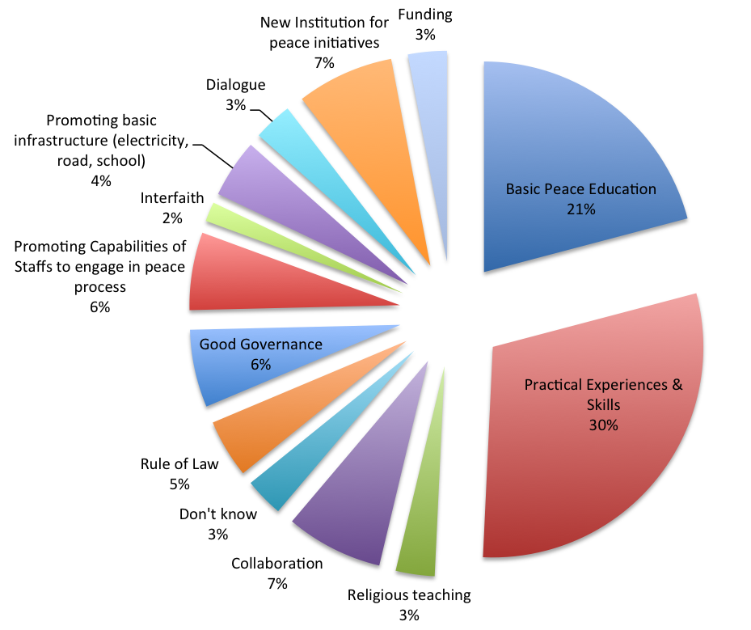
III. What kind of peace skills and knowledge are needed in order to build or to strengthen peace infrastructure in Southern Shan State? Why?

Slide 9

To be continue. . . . .

