Slide 1
The Role of Trust in Peace Accord Implementation: A Case in the Bangsamoro
Alfredo Lubang
National Coordinator
Philippine Campaign to Ban Landmines (PCBL)

Slide 2
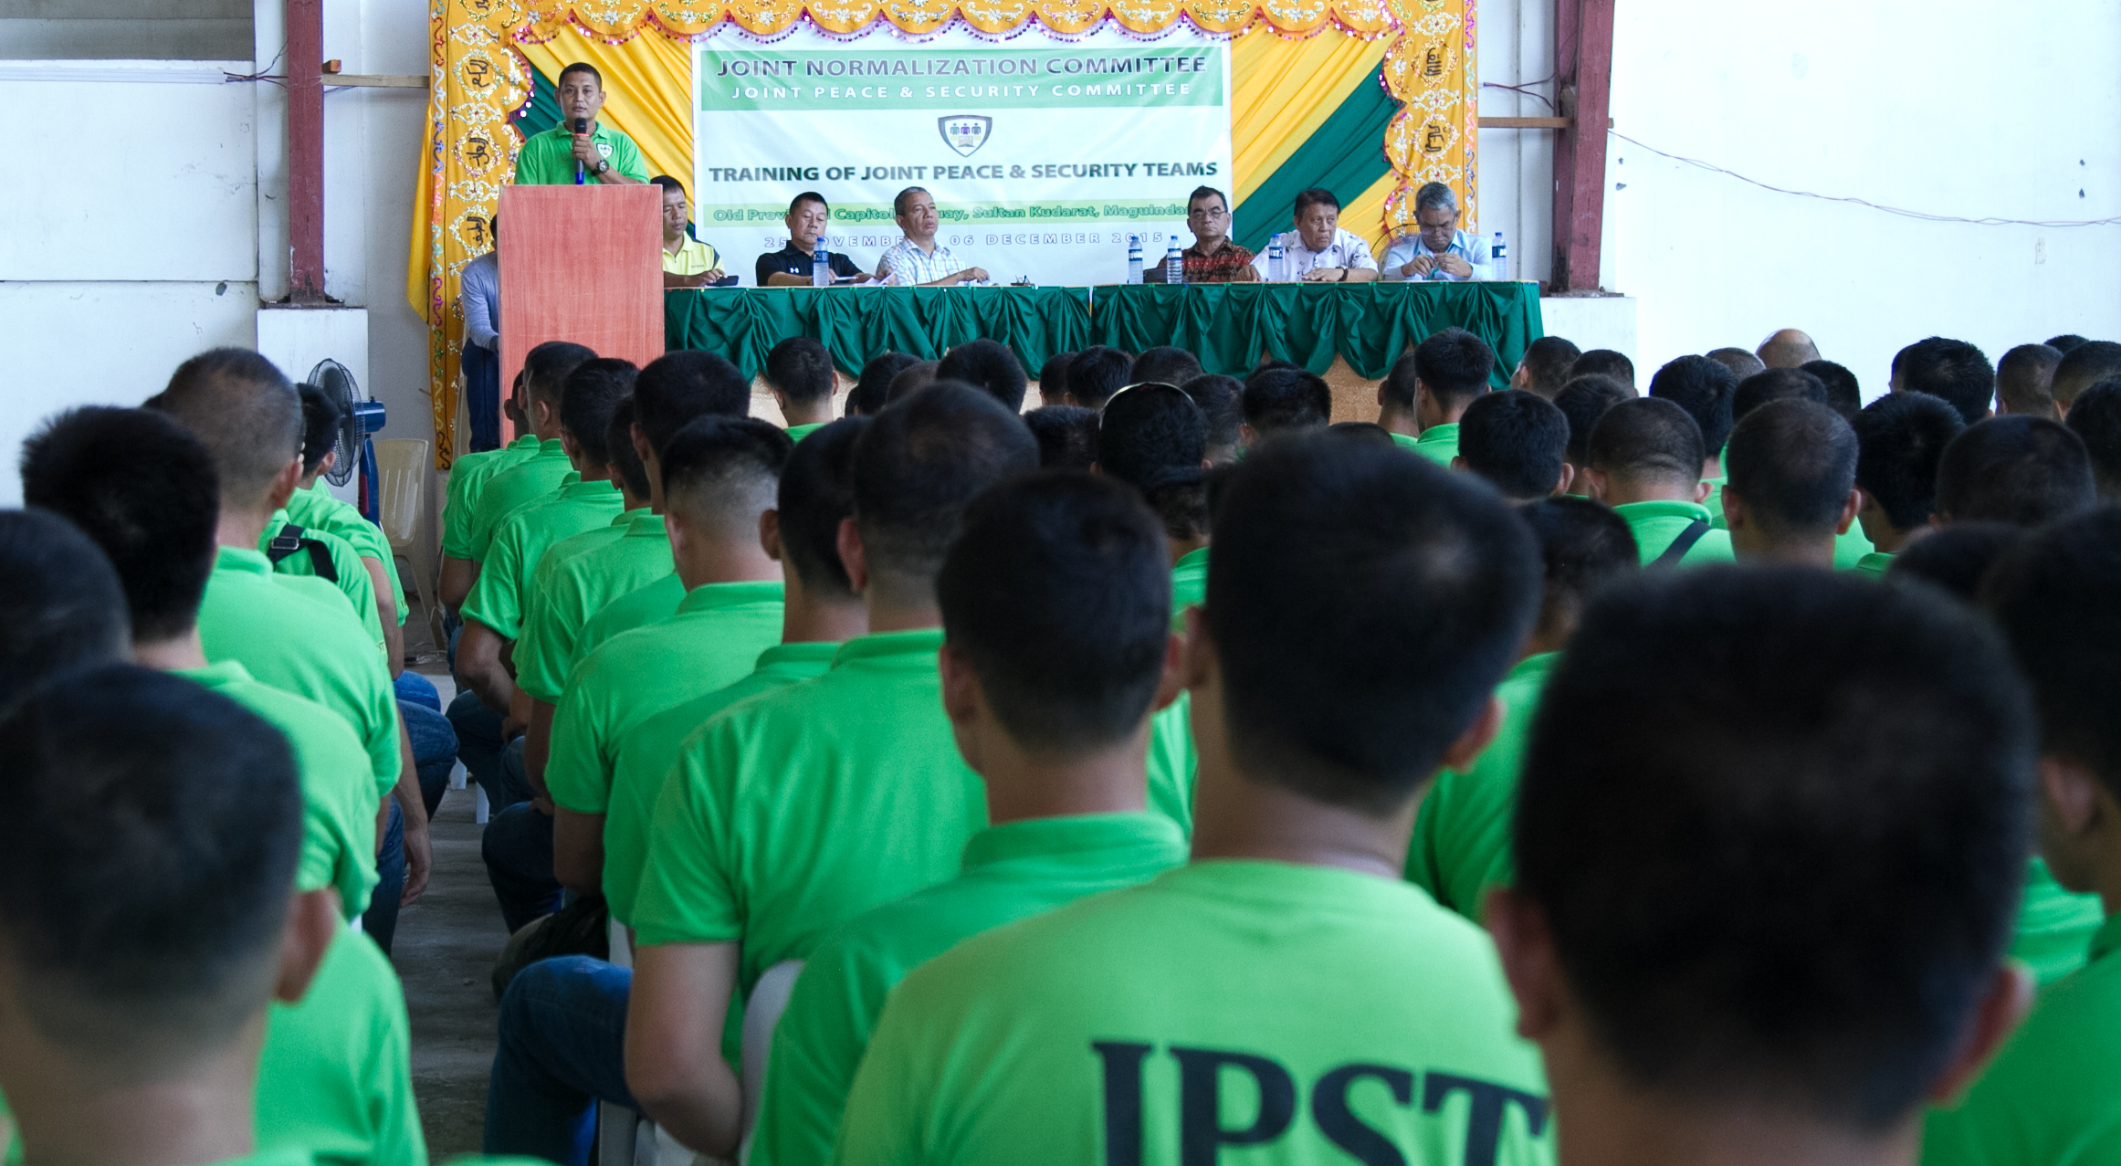
“Thank you to Allah (SWT) for giving us the chance to serve. We need to trust each other -- unlike before only our guns talk to each other.” Mujahid Felix Macalimbas, BIAF, JPST member
What does he exactly mean when he referred to trust? How is trust defined by individuals?

Slide 3
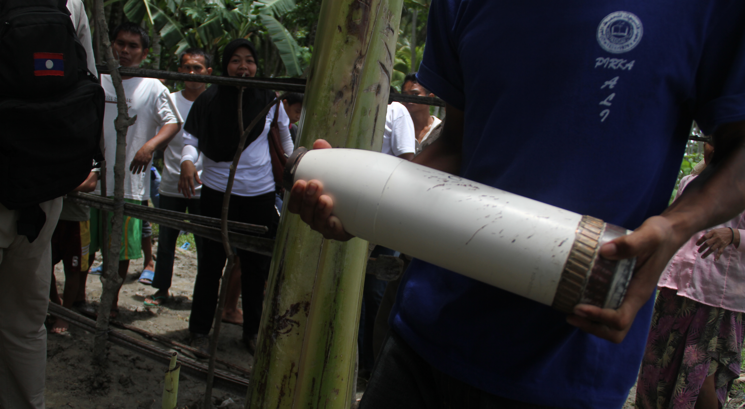
“Is this what you’re looking for?”
What was the basis of trust, that they turned it over?

Slide 4
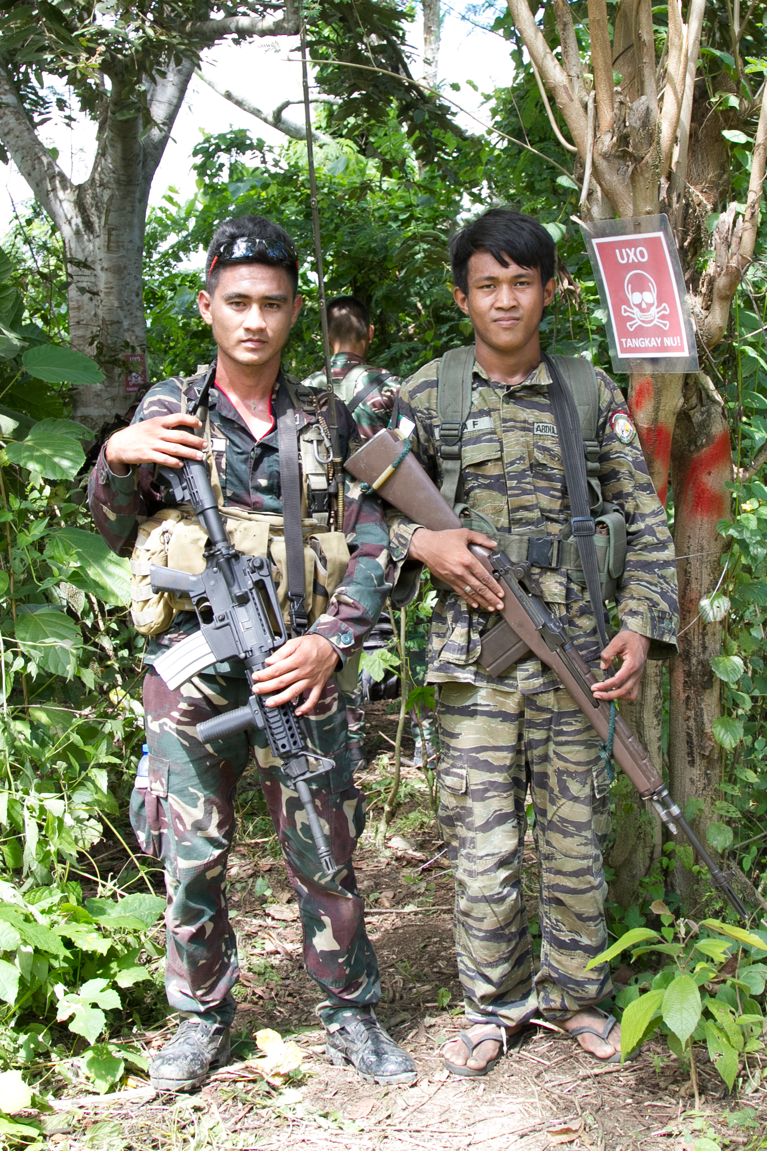
What factors sustain trust?

Slide 5
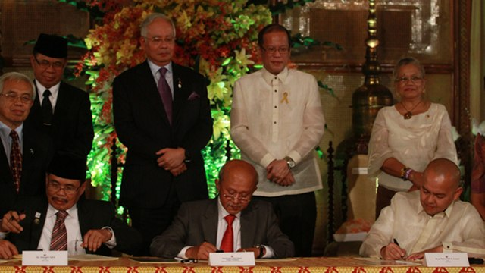
“This agreement is about rising above our prejudices. It is about casting aside the distrust and myopia that has plagued the efforts of the past; it is about learning hard lessons and building on the gains we have achieved. It is about acknowledging that trust has to be earned—it is about forging a partnership that rests on the bedrock of sincerity, good will, and hard work.”

Slide 6
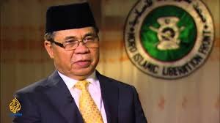
“The trust has been affected”
Chairman Murad on the Mamasapano incident.
Screengrab from Aljazeera
what factors diminish trust ?

Slide 7
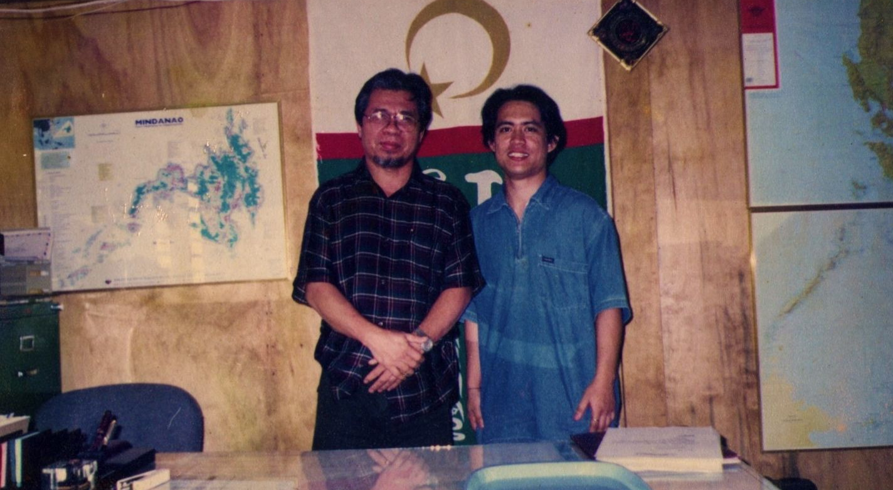
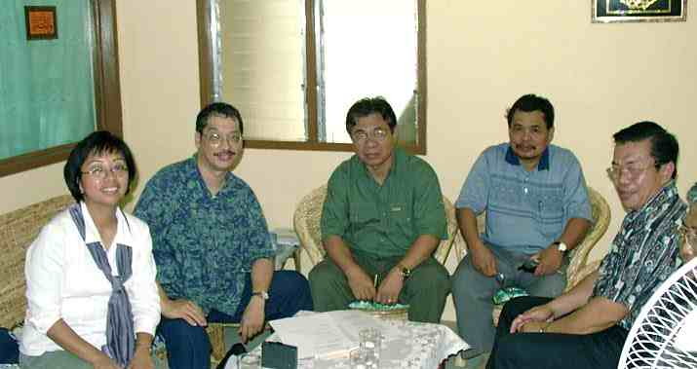
Engaging the Moro Islamic Liberation Front to ban landmines in the 1990s
How is trust perceived within/among/between groups?

Slide 8
Implementing Peace Agreements
Signing of peace agreements does not mean implementing it.
More than 50% of peace agreements signed surpass 5 years from signing before conflict resume
Peace agreement implementation is more practiced than studied.
After years of fighting, there are trust issues especially if both parties implement the agreements they made together

Slide 9
Micro/Individual level
Relationship-based perspective
“psychological state held by the follower involving confident positive expectations about the behavior and intentions of the leader (Dirks 2006)
Character-based perspective
“the perception of the leader’s character and how it impacts a follower’s vulnerability in a hierarchical relationship “ (Dirks 2006)
Limitation: the follower solely gives trust

Slide 10
Organizational/Group level
Balance between trust and task control (Long and Sitkin 2006)
Balance between investing in monitoring opportunistic behavior and investing in development of an atmosphere of trust (Madhok, 2006)

Slide 11
Societal level
Luhmann (2000) further nuanced the concepts of familiarity, confidence and trust in relation to expectations, disappointment and risks

Slide 12

Simmel’s Theoretical Framework
Weak link between the bases of trust and the trustful state of expectations
“Kind of Faith”
Bases of Trust
Trustful State of Expectations

Slide 13
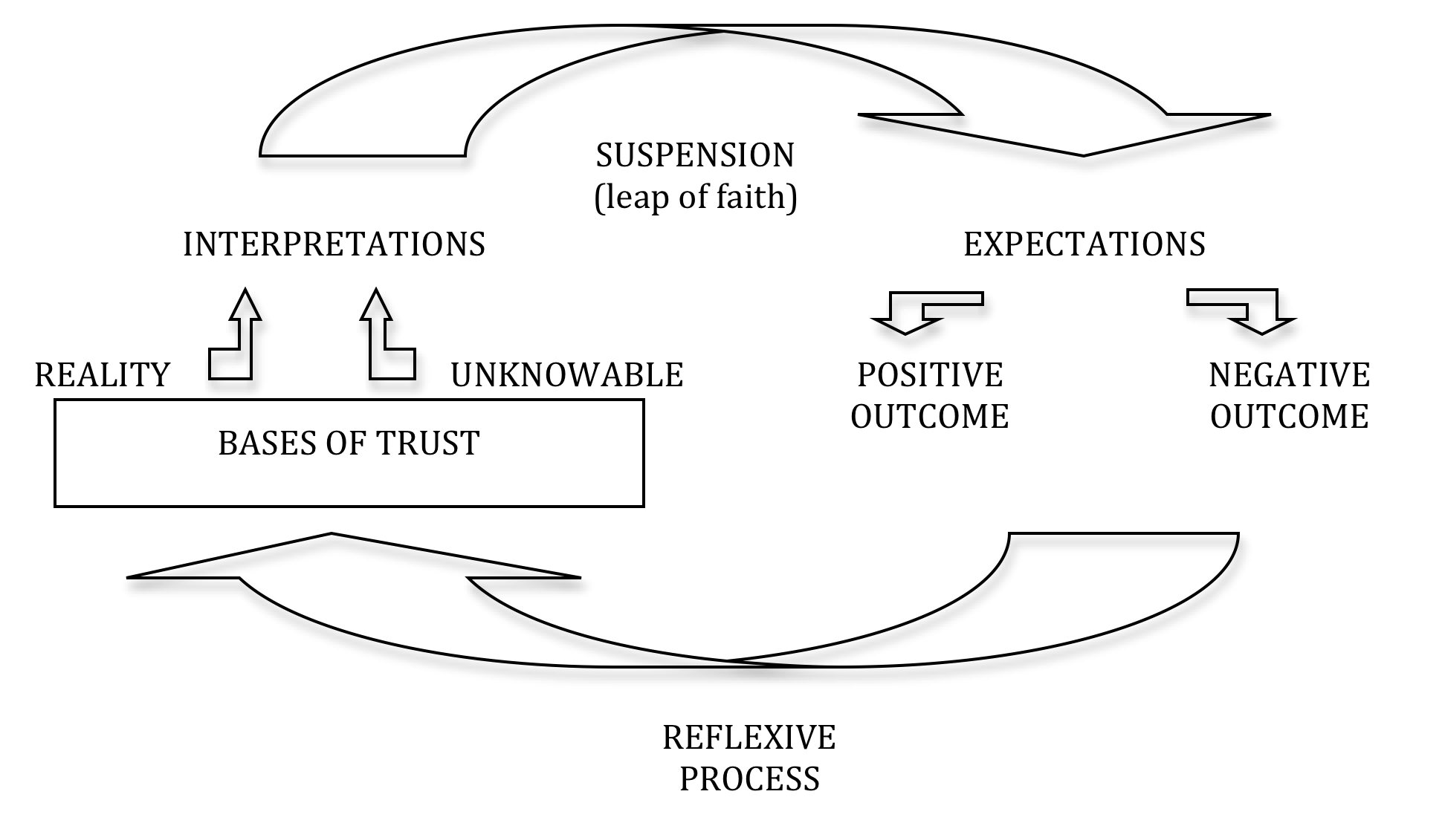
Mollering’s Framework

Slide 14
Operational Definition of Trust
“Trust as a reflexive process of building on reason, routine and reflexivity, suspending irreducible social vulnerability and uncertainty as if they were favourably resolved, and maintaining a state of favourable expectation towards the actions and intentions of more or less specific others (Möllering, 2006)

Slide 15
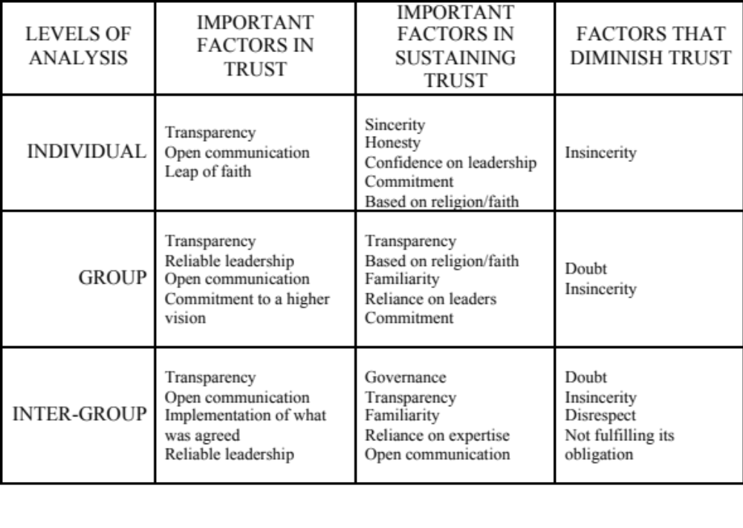
FINDINGS
Perceptions of Trust In Peace Accord Implementation

Slide 16
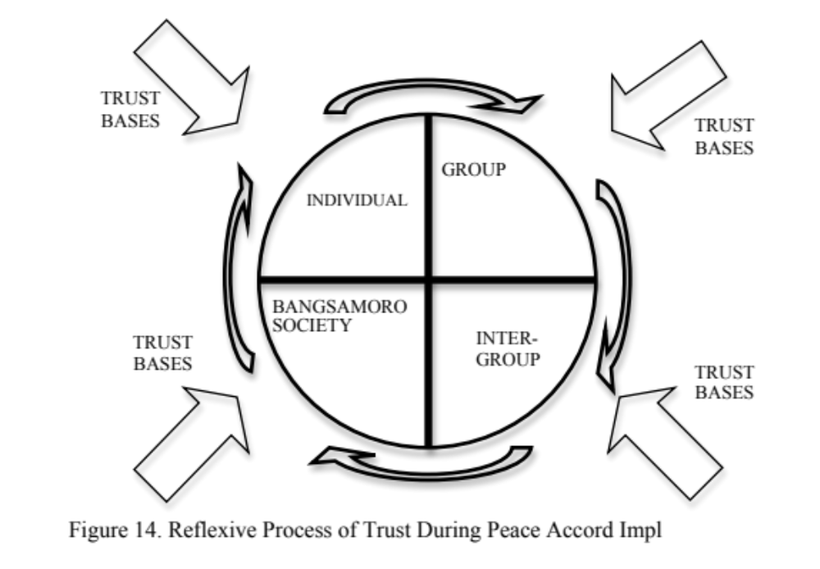

Slide 17
V. Conclusions
Based on the findings of this action research, trust is a reflexive process derived from their direct encounters and experiences with their partners in implementing a peace accord, where positive outcome builds reason.
Notes:
Based on the findings of this action research, trust is a reflexive process derived from their direct encounters and experiences with their partners in implementing a peace accord, where positive outcome builds reason.
Establishing implementing mechanisms with clear obligations and responsibilities but giving room for flexibility forms routine. Reflexivity happens when people form trust bases which they then process based on realities and positive outcome weighing these two against the unknowable. Through the trust bases and reflexive process, individuals or groups reach a trustful state with the notions of arriving at a positive outcome propelling them to take that leap of faith.
Therefore, trust is very crucial in implementing peace accords because it creates an enabling environment where there is suspension of the unknowables that allows that ‘leap of faith’ which in turn creates spaces for understanding and flexibility, therefore giving peace a chance during implementation of peace accords.

Slide 18
Conclusions
2. Establishing implementing mechanisms with clear obligations and responsibilities but giving room for flexibility forms routine.
3. Reflexivity happens when people form trust bases which they then process based on realities and positive outcome weighing these two against the unknowable.

Slide 19
V. Conclusions
4. Through the trust bases and reflexive process, individuals or groups reach a trustful state with the notions of arriving at a positive outcome propelling them to take that leap of faith.
Notes:
Reflexivity happens when people form trust bases which they then process based on realities and positive outcome weighing these two against the unknowable. Through the trust bases and reflexive process, individuals or groups reach a trustful state with the notions of arriving at a positive outcome propelling them to take that leap of faith.
Therefore, trust is very crucial in implementing peace accords because it creates an enabling environment where there is suspension of the unknowables that allows that ‘leap of faith’ which in turn creates spaces for understanding and flexibility, therefore giving peace a chance during implementation of peace accords.

Slide 20
Recommendations
For the future Bangsamoro
The Basic Law for the future Bangsamoro should have provisions that will allow the freedom of information.
Prior to the approval of the Basic Law, the MILF leadership should put in place a mechanism for transparency and open communication where every one’s right to know are respected and attained.
Notes:
For the future Bangsamoro
The Basic Law for the future Bangsamoro should have provisions that will allow the freedom of information. This provision will empower every Bangsamoro to become part in implementing the comprehensive agreement and, consequently, sustaining the level of trust as institutions are built.
Prior to the approval of the Basic Law, the MILF leadership should put in place a mechanism for transparency and open communication where every one’s right to know are respected and attained.

Slide 21
Recommendations
For the leaders of the MILF and the Government of the Philippines and its agencies
3. A trustful state of leadership of both parties should be sustained.
4. Set-up institutions and mechanism that will carry on the momentum of trust built after the signing of the FAB.
5. Guarantees should be in place, making sure that agreements will be implemented, by creating mechanisms and/or policies assuring commitments, obligations and expectations are met.
Notes:
For the leaders of the MILF and the Government of the Philippines and its agencies
It is crucial that President Benigno Aquino, Jr. is trusted by the MILF, likewise, the Aquino administration trust the current crop of leadership of the MILF. This state of trustful state of leadership of both parties should be sustained.
Set-up institutions and mechanism that will carry on the momentum of trust built after the signing of the FAB. The trust between the current leadership of the MILF and the Aquino administration should go beyond 2016 when the Philippines undergo the national elections.
Guarantees should be in place, making sure that agreements will be implemented, by creating mechanisms and/or policies assuring commitments, obligations and expectations are met. More involvement of third parties (international organizations and institutions, local civil society) should be in place to provide guarantees.

Slide 22
Recommendations
For the implementers of peace accords
6. Implementing guidelines/TOR/MOU/MOA should include provisions that will sustain trust.
7. A clear delineation of roles, responsibilities, communication channels and transparency mechanisms and a room for flexibility to change what will not work should be laid out.
8. Mechanism for sharing of information to the community and the larger society about the developments and updates on the implementation of the accord should be in place.
Notes:
For the implementers of peace accords
Implementing guidelines, Terms of Reference (TOR), Memorandum of Understanding (MOU) and Memorandum of Agreement (MOA) which will be drawn from the comprehensive peace agreement should include provisions that will sustain trust. In order to do so, transparency measures should always be there.
A prerequisite in peace accord implementation is a clear delineation of roles, responsibilities, communication channels and transparency mechanisms and a room for flexibility to change what will not work. Insincerity and doubt, whether it is just perceived or actually true has the same effect, it will diminish trust and will put stumbling blocks to implementations.
Mechanism for sharing of information to the community and the larger society about the developments and updates on the implementation of the accord. One of the clear findings of this research is that people would want to know what is happening to earn their continued trust.

Slide 23
Recommendations
For the community
9. Communities affected by the armed conflict and violence should take the lead in engaging the institutions;
10. Continue to make your governments (Philippine and the future Bangsamoro) continue to be champions of your rights and freedom.
Notes:
For the community
Communities affected by the armed conflict and violence should take the lead in engaging the institutions;
This is your negotiated future. This is about implementing a peace accord that will hopefully end the armed conflict. But you all know that this is not the only armed group in Mindanao. However, the success of the implementation of the peace agreement of the GPH and the MILF will enable an environment that peace is indeed possible and sustainable allowing other armed groups to witness how you struggle for peace. Continue to make your governments (Philippine and the future Bangsamoro) continue to be champions of your rights and freedom.

Slide 24
Shukran, orkun charan, daghang salamat – thank you!

